Slide 1

MBEYA UNIVERSITY OF SCIENCE AND TECHNOLOGY
COLLEGE OF INFORMATION AND COMMUNICATION TECHNOLOGY
DEPARTMENT OF ELECTRONICS AND TELECOMMUNICATION ENGINEERING
TITLE:EXPLAINABLE AI MODEL FOR PULMONARY EDEMA DETECTION IN CHEST X-RAY IMAGES
Student Name: BONIFACE BEN SANKWA
Registration number: 22100934340091
Supervisor: Dr. NYATEGA
TITLE: EXPLAINABLE AI MODEL FOR PULMONARY EDEMA DETECTION IN CHEST X-RAY IMAGES

Slide 2
PROJECT OBJECTIVES
Main Objective
To develop an Explainable AI system for detecting pulmonary edema in chest X-ray images, capable of providing diagnostic results along with visual explanations of the regions used for prediction.
Specific Objectives
Collect and preprocess chest X-ray datasets.
Train a CNN model for detection.
Apply Explainable AI techniques.
Evaluate model performance and Develop a simple web interface.
Notes:
Specific Objectives
Study pulmonary edema features in X-ray images.
Collect and preprocess chest X-ray datasets.
Train a CNN model for detection.
Apply Explainable AI techniques.
Evaluate model performance and
Develop a simple web interface to display predictions and heatmaps.

Slide 3
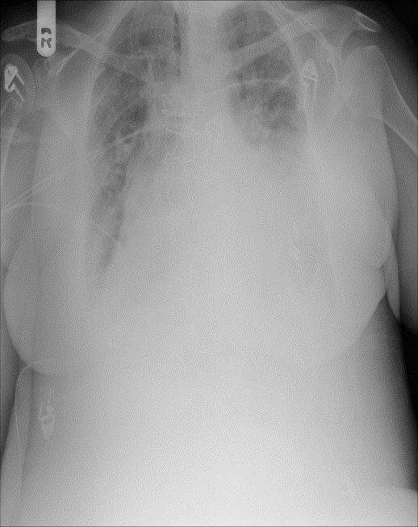
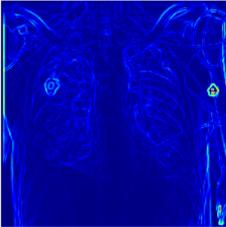
CONCEPTUAL DIAGRAM
INPUT
PREPROCESSING
AI MODEL
EXPLAINABLE AI
OUTPUT
Image enhancement
Normalization
Resizing
CNN model
Pulmonary Edema detection
Detection Result
Explanations
DenseNet121

Slide 4
IMPLEMENTATION DESIGN

Slide 5


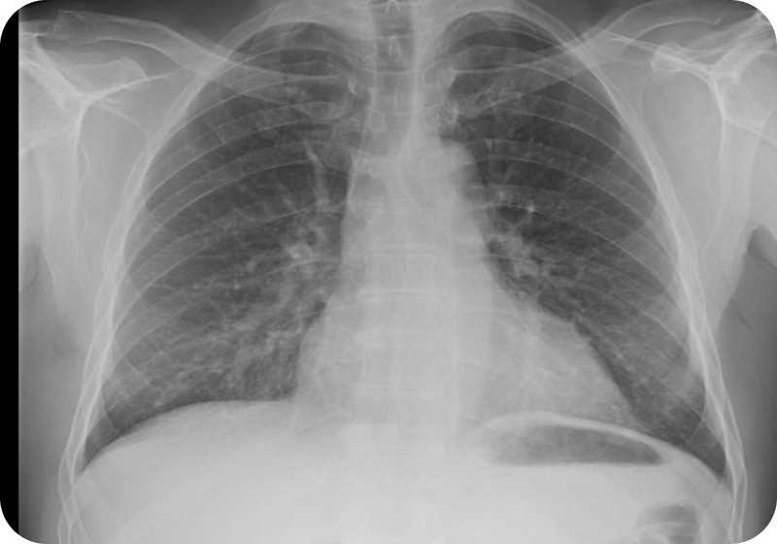
🫁
Welcome Back
PulmoXAI
Login to continue using PulmoXAI
Email Address
Explainable AI for Pulmonary Edema Detection in Chest X-Ray Images
Password
👁️
Forgot Password?
Chest X-Ray Illustration
Login

Slide 6



🔍 Search patient...
🔔
Dr. Sabo
🫁
PulmoXAI
Dashboard Overview
Overview of AI Detection System
Dashboard
📷
⚠️
✅
🎯
Total X-Rays
Edema Cases
Normal Cases
Model Accuracy
Upload X-Ray
1,000 images
500
500
85.0%
Predictions
Grad-CAM
Recent Analyses
Reports
Patient ID
Date
Diagnosis
Confidence
Report
PX001
01/06/2026
Edema
79.8%
View
History
PX002
01/06/2026
Edema
89.2%
View
PX003
02/06/2026
Normal
77.2%
View
PX004
03/06/2026
Edema
66.5%
View
PX005
03/06/2026
Edema
73.2%
View
PX006
04/06/2026
Normal
88.2%
View
PX007
05/06/2026
Normal
81.6%
View
PX008
06/06/2026
Edema
79.5%
View
Logout

Slide 7


🔍 Search patient...
🔔
Dr. Sabo
🫁
PulmoXAI
Upload Chest X-Ray
Upload a chest X-ray image for pulmonary edema detection.
Dashboard
Upload X-Ray
Predictions
Grad-CAM
Drag and Drop Chest X-Ray Here
Supported: JPG, JPEG, PNG
Maximum Size: 10 MB
Reports
Browse Files
History
Patient Information
Patient ID
PX001
Age
45
Gender
GENDER
No image selected
Examination Date
30/05/2026
Analyze Image
Clear Form
Logout

Slide 8
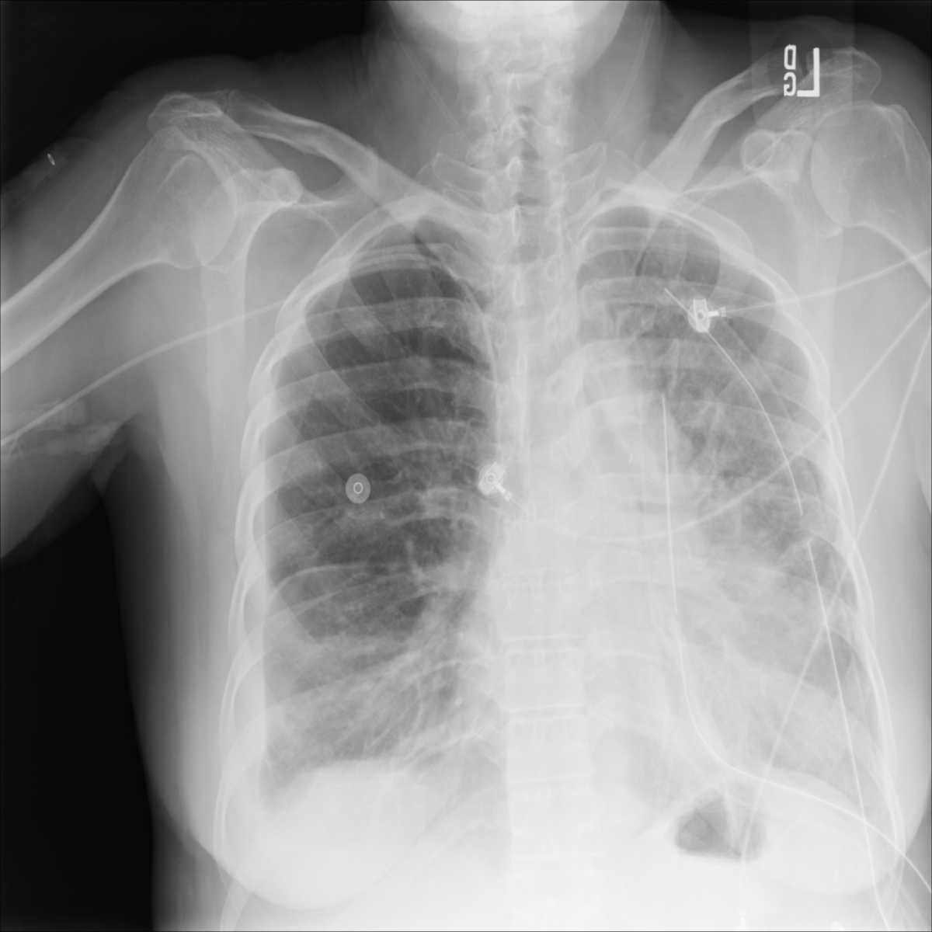
🔍 Search patient...
🔔
Dr. Sabo
🫁
PulmoXAI
Prediction Results
AI analysis result for uploaded chest X-ray
Dashboard
Chest X-Ray Image
Upload X-Ray
PREDICTION RESULT
DIAGNOSIS:PULMONARY EDEMA
Predictions
CONFIDENCE: 87.3%
RISK LEVEL: HIGH RISK
Grad-CAM
RAW SCORE: 0.873
Reports
History
AI Interpretation
The model detected imaging patterns
consistent with pulmonary edema,
particularly in the lower lung regions.
Uploaded Image
Logout
View Grad-CAM
Generate Report
Analyze New Image

Slide 9
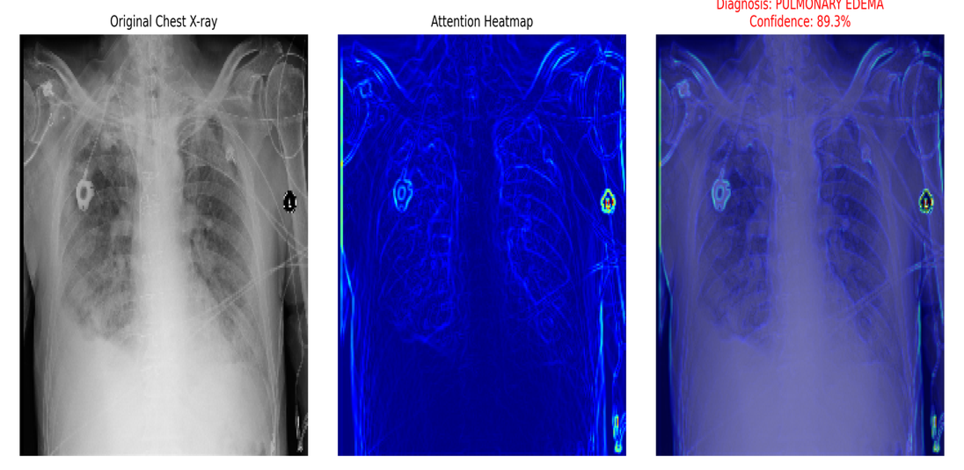
🔍 Search patient...
🔔
Dr. Sabo
🫁
PulmoXAI
Explainable AI Analysis
Visualization of regions that influenced the AI prediction.
Dashboard
Original Chest X-Ray
Upload X-Ray
Predictions
Grad-CAM
Reports
History
Logout
Download Heatmap
Generate Export Visualization
Analyze New Image

Slide 10
🔍 Search patient...
🔔
Dr. Sabo
🫁
PulmoXAI
🫁
RPT-2026-0001
AI Diagnostic Report
01 June 2026
Explainable AI for Pulmonary Edema Detection
Dashboard
Mbeya Referral Hospital
Completed
Upload X-Ray
Patient Information
Predictions
Patient ID
Age
Gender
Examination Date
Grad-CAM
PX001
45
Male
01/06/2026
Reports
History
Diagnostic Summary
Pulmonary Edema Detected
Confidence Score: 87.3%
Model used: DenseNet121 + Grad-CAM
Logout

Slide 11
🔍 Search patient...
🔔
Dr. Sabo
🫁
PulmoXAI
Patient History
Dashboard
View previous analyses and reports
Upload X-Ray
Predictions
Patient Records Table
Grad-CAM
Patient ID
Date
Diagnosis
Confidence
Report
Reports
PX001
01/06/2026
Edema
79.8%
View
PX002
01/06/2026
Edema
89.2%
View
History
PX003
02/06/2026
Normal
77.2%
View
PX004
03/06/2026
Edema
66.5%
View
PX005
03/06/2026
Edema
73.2%
View
PX006
04/06/2026
Normal
88.2%
View
PX007
05/06/2026
Normal
81.6%
View
PX008
06/06/2026
Edema
79.5%
View
Logout

Slide 12
THANK YOU
https://drive.google.com/drive/folders/15MdHUPmac4TKWttEiaGW3ekv5IQkMNyH

